Slide 1


In association with
“Business Analytics with R”
Group-E Presents…

Slide 2


EPISODEs:
Data Exploration & Visualization
[Classification] Decision Tree
[Classification] Logistic Regression

Slide 3

Episode 1: DATA EXPLORATION & VISUALIZATION

Slide 4
1.1 Each Variables Statistics And Specification

Slide 5
1.2 Outlier Detection by using Box Plot and Pre-processing

Slide 6


Episode 2: [Classification] Decision Tree

Slide 7
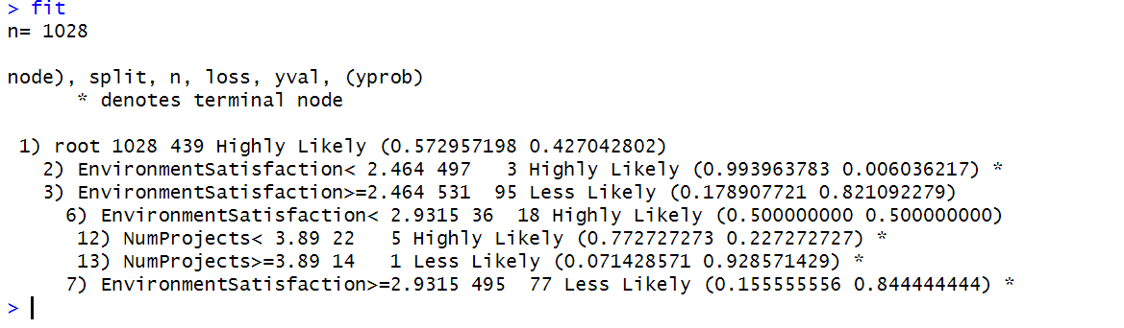
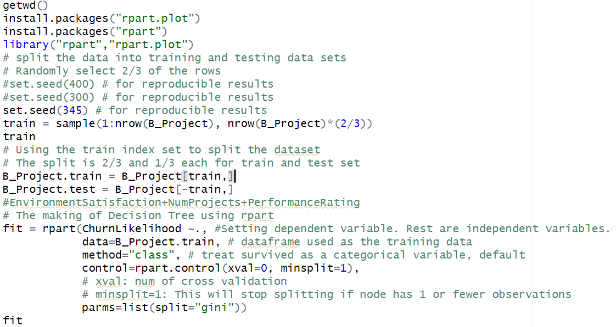
Splitting the data into training and test data
Growing a tree and displaying basic results

Slide 8
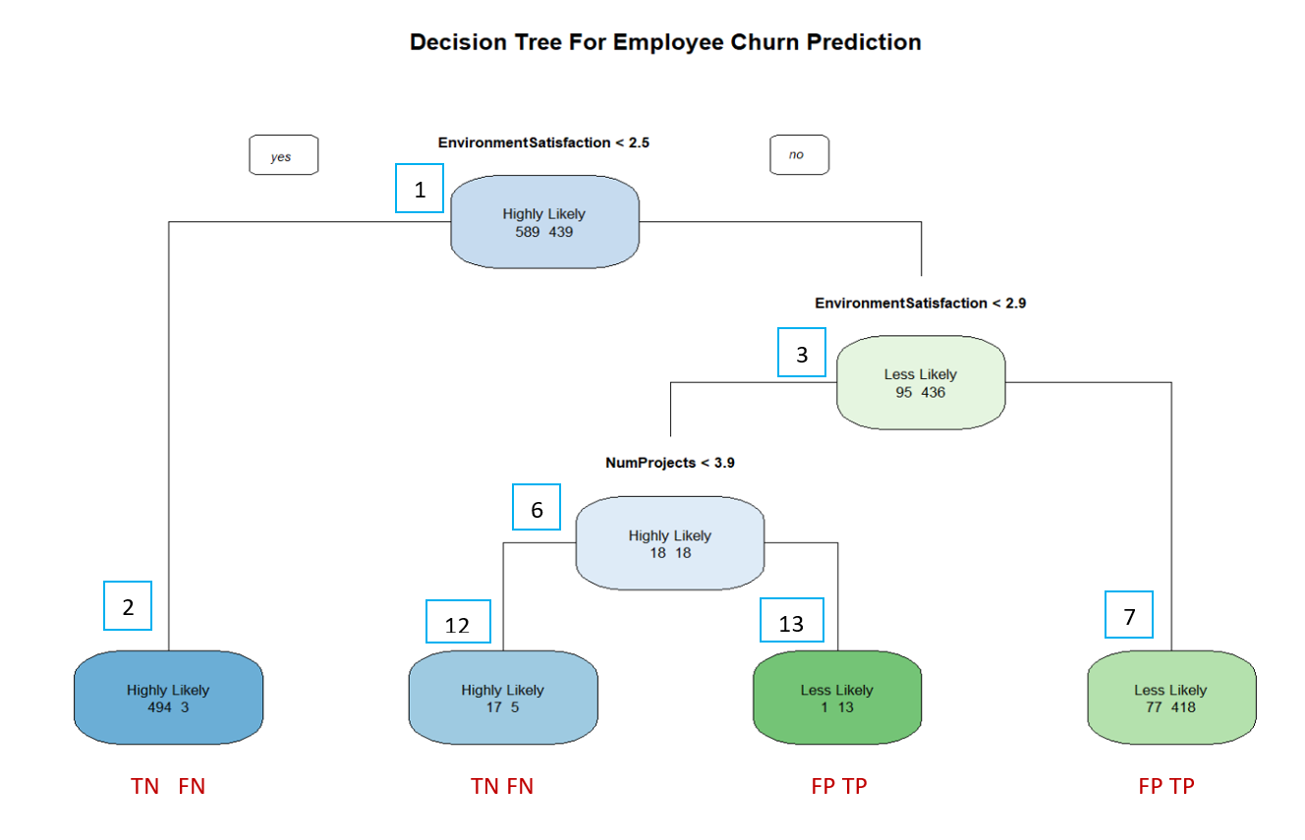
Plotting the Decision tree rpart.plot(fit, type = 1, extra = 1,main ="Decision Tree For Employee Churn Prediction")
Tree Interpretation
Definitions
True Positive (TP):
Pred Pos & Actual Pos
False Positive (FP):
Pred Pos & Actual Neg
True Negative (TN):
Pred Neg & Actual Neg
False Negative (FN):
Pred Neg & Actual Pos

Slide 9
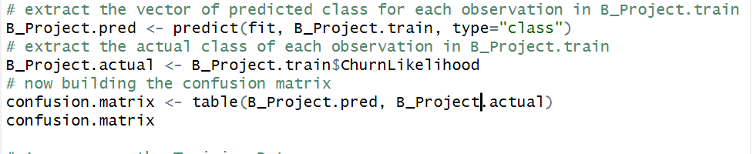
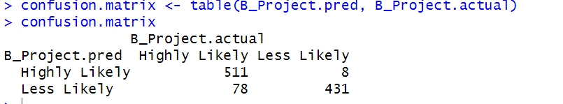
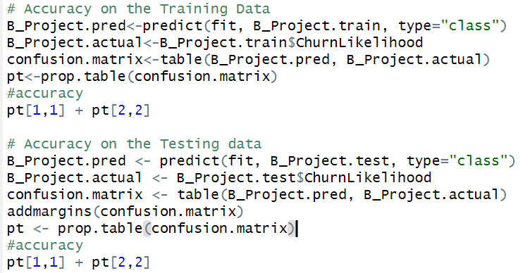
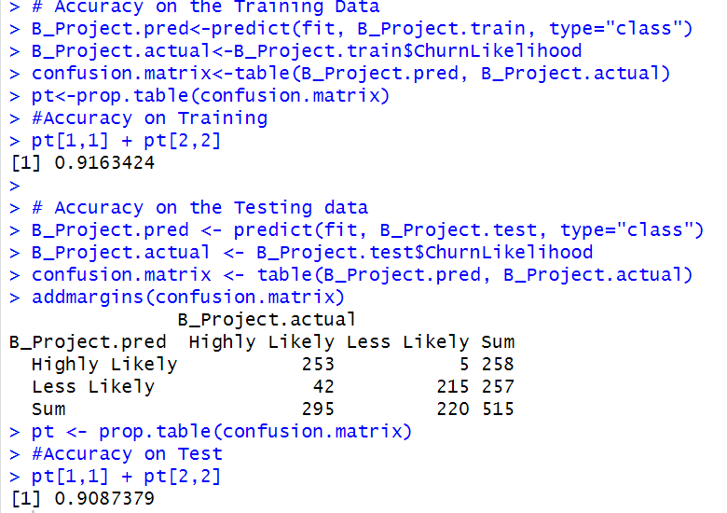
Accuracy on Training/Test Data & Interpretation
Summary
TP = 418+13 = 431
FP = 1+77 = 78
TN = 494 +17 = 511
FN = 3+5 = 8
Overall Performance Accuracy (0.916)
= Total Correct / Total Number of Obs.
= (TP + TN)/(TP+FP+TN+FN)
= (431+511)/(431+78+511+8) = 0.916
Error Rate = Total Incorrect / Total Number of Obs.
= 1 – Accuracy = 1-0.737 = 0.084
TPR = Recall = (Sensitivity) = TP/P = 431/(431+78) = 0.847
TNR = (Specificity) = TN/N = 511/(511+8) = 0.985
FPR = FP/N = Type 1 Error Rate (α)= 78/(519) = 0.151
FNR = FN/P = Type 2 Error Rate (β)= 8/(509) = 0.0157

Slide 10
2.4 Accuracy on the training & test data

Slide 11



Slide 12

Episode 3: [Classification] Logistic Regression
No one’s leaving the room until u watch the...

Slide 13
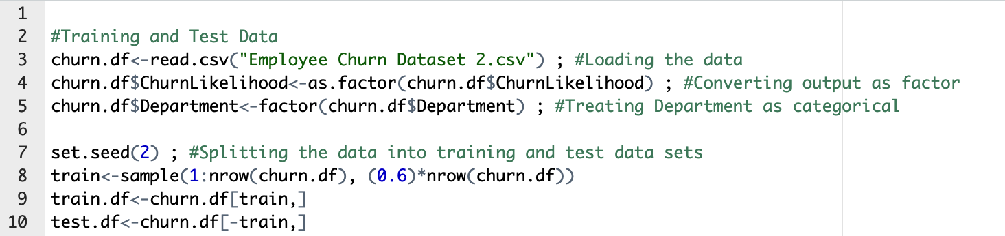
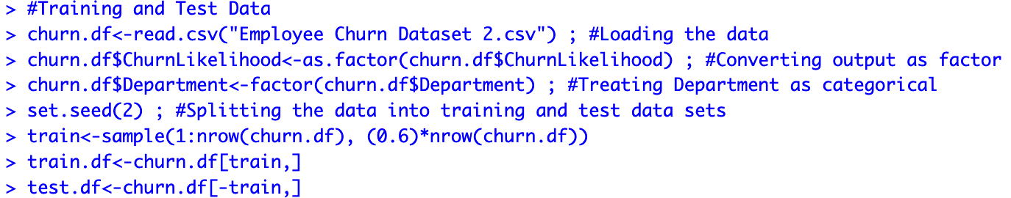
3.1 Splitting the data into training and test data

Slide 14
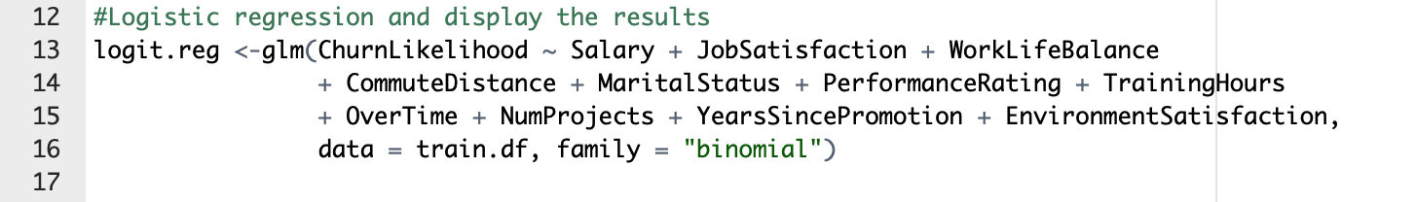
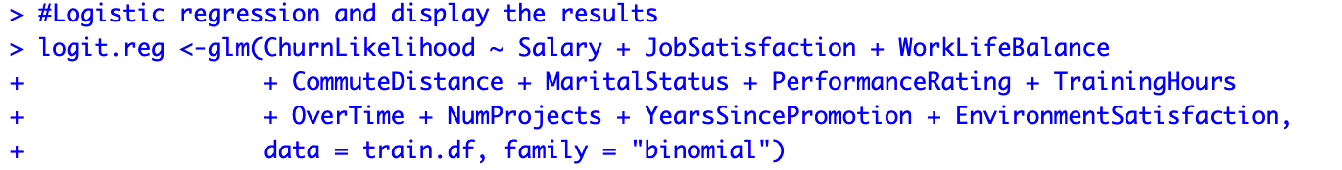
3.2 Logistic regression and display the results

Slide 15
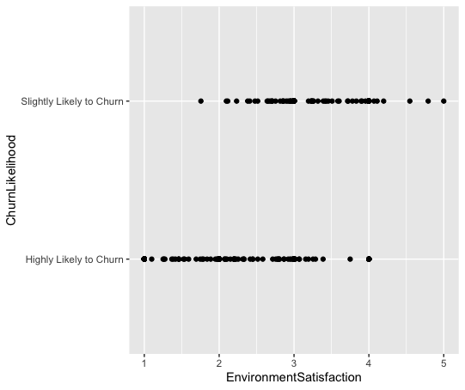
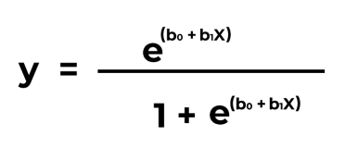

Slide 16
3.3 Accuracy on the training & test data

Slide 17
3.4 Splitting the data into training and test data

Slide 18
The OFFICE
Group-E Presents…
Business Analytics with R

